Slide 1

E-INVOICE
Group 3
Project Assignment
Nguyễn Nhật Quang
Châu Hồ
Lê Thanh Liêm
Hồ Quốc Thịnh
Chu Thanh Trí
Võ Đình Thi
Java Fresher Program 2018
March 16, 2018

Slide 2

E-INVOICE
Monthly invoice management in a family
Report of monthly expenses
Help you make plan to save money
Java Fresher Program 2018
March 16, 2018

Slide 3
FUNCTIONS
Register account
CRUD
Invoice, Type
Set the monthly limited
View expenses report
View charts
ADMIN
Activate
Deactivate
USER
Java Fresher Program 2018
March 16, 2018

Slide 4
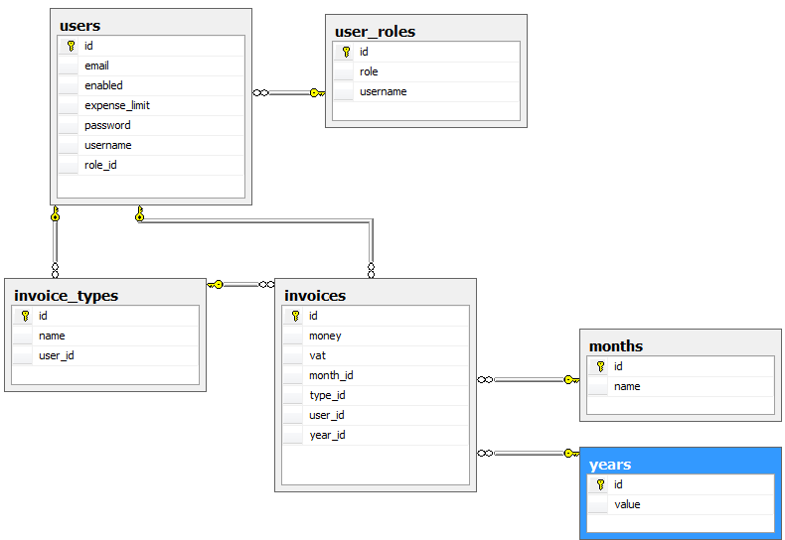
DATABASE DIAGRAMS
Java Fresher Program 2018
March 16, 2018

Slide 5
TECHNICAL USING
Framework
Client Side
Database System
Source Control
Spring MVC | Bootstrap | SQL Server | GitHup
Hibernate | HTML5/CSS3
Spring security
Java Fresher Program 2018
March 16, 2018

Slide 6
DEMO
Java Fresher Program 2018
March 16, 2018

Slide 7

THANKS!
Any questions?
Group 3
Java Fresher Program 2018
March 16, 2018

